Slide 1
AI: Introduction
Course Code: CSC4226
Course Title: Artificial Intelligence and Expert System
Dept. of Computer Science
Faculty of Science and Technology
Lecture No: | Theory-01 | Week No: | One | Semester:
Instructor | Dr. Muhammad Firoz Mridha, Associate Professor, Dept of CS Email: firoz.mridha@aiub.edu

Slide 2
Lecture Outline
What is AI?
The Foundations of AI.
Brief History of AI
The State of the Art.
Course Outline by Topics and Weeks.

Slide 3
Course Objectives
Get an overview of artificial intelligence (AI) principles and approaches.
Develop a basic understanding of the building blocks of AI as presented in terms of intelligent agents: Search, Knowledge representation, inference, logic, learning.
Develop a brief overview of AI applications: Expert Systems and Planners.
Follow AI literature with the ability to go on to independent work in the field.

Slide 4
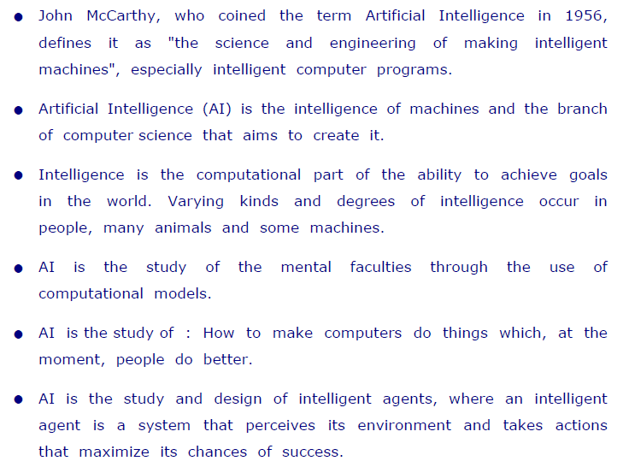
What is Artificial Intelligence ?

Slide 5
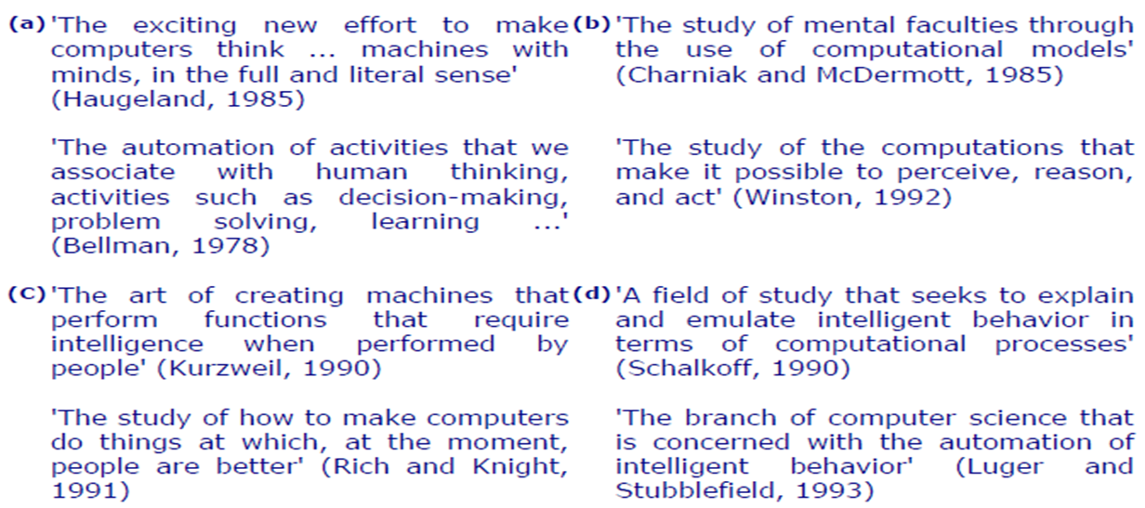
Definition of AI: Outlined in Textbox

Slide 6

Intelligent Behavior

Slide 7
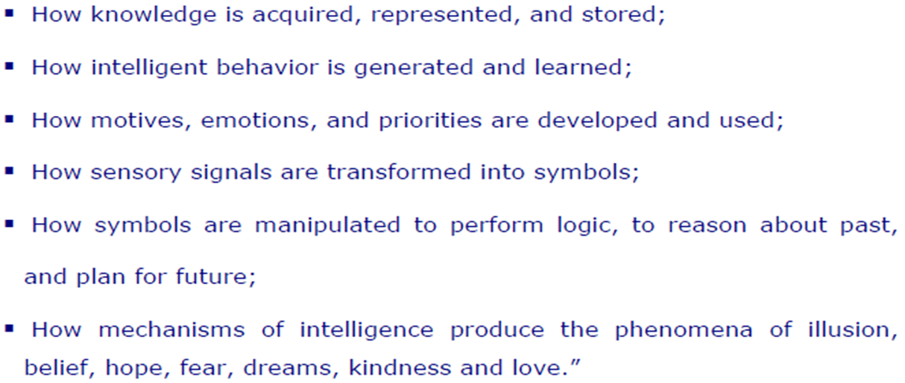
Understanding AI

Slide 8
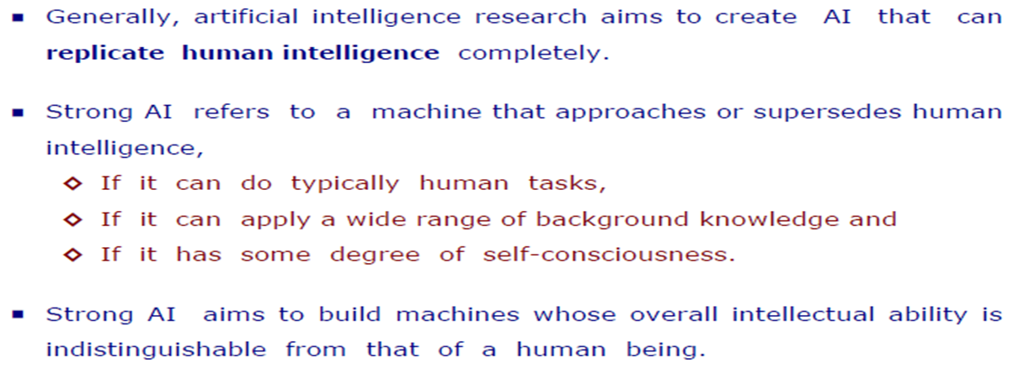
Types of AI
Hard or Strong AI

Slide 9
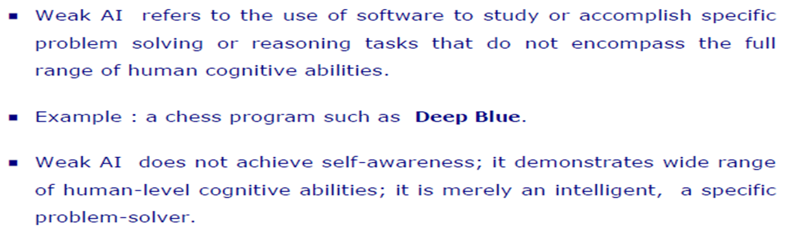
Types of AI
Soft or Weak AI

Slide 10
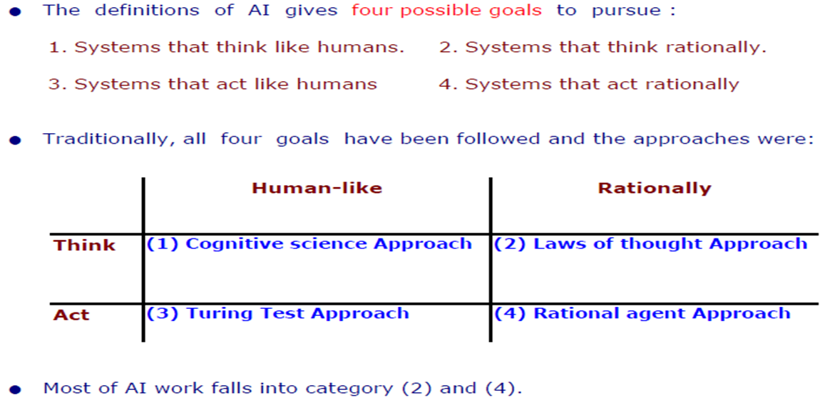
Goals of AI

Slide 11
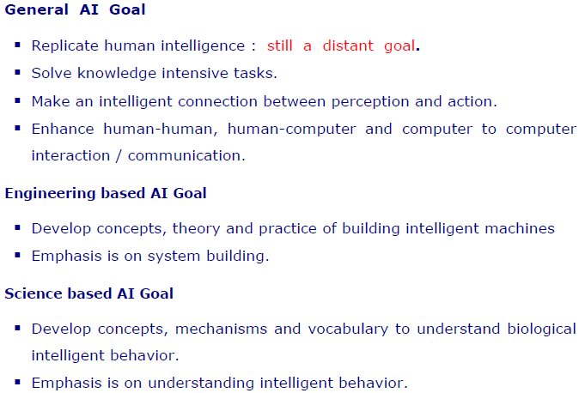
Goal of AI
Continued…

Slide 12
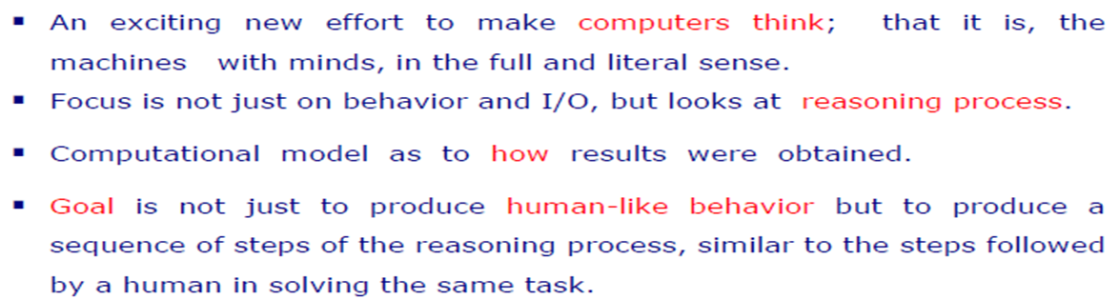
AI Approaches
Cognitive Science : Think Humanly

Slide 13
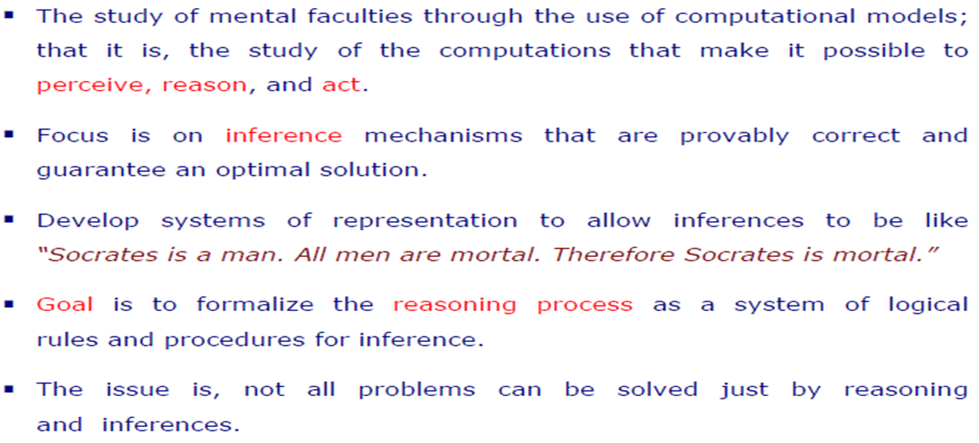
AI Approaches
Laws of Thought: Think Rationally

Slide 14
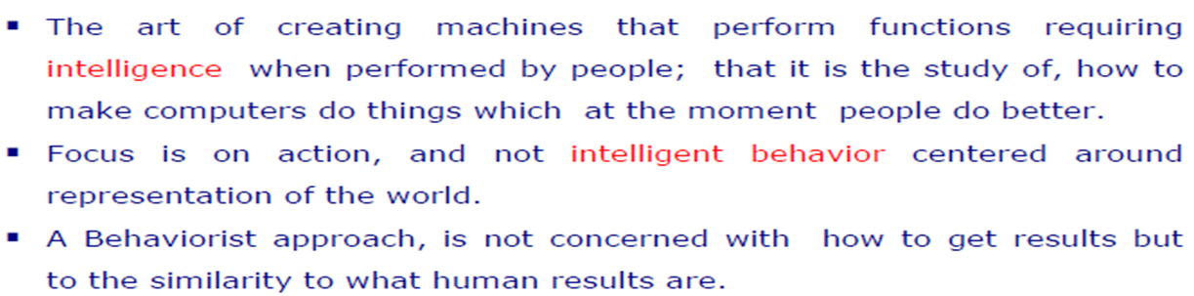
AI Approaches
Turing Test: Act Humanly

Slide 15
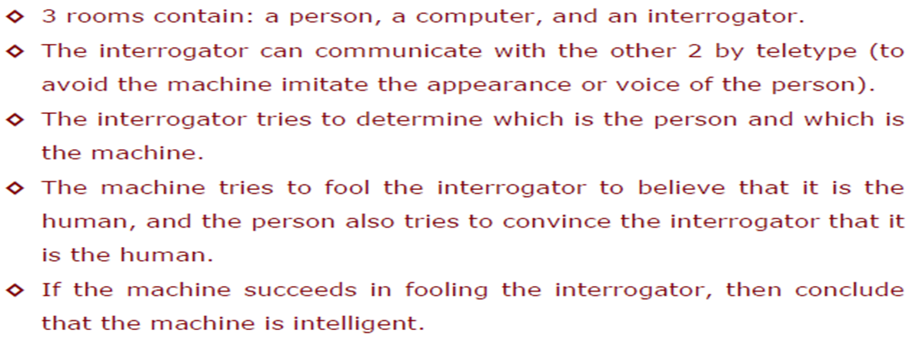
AI Approaches
Turing Test

Slide 16
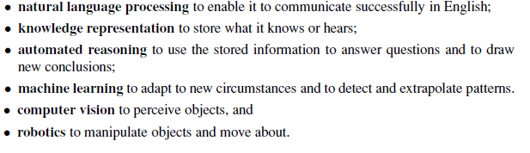
AI Approaches
Turing Test : Capabilities Required to Pass Complete Turing Test

Slide 17
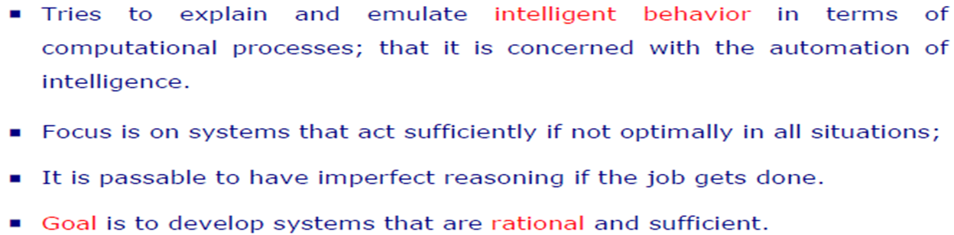
AI Approaches
Rational Agent: Act Rationally

Slide 18
Course Code: CSC4226
Course Title: Artificial Intelligence and Expert System
Dept. of Computer Science
Faculty of Science and Technology
Lecture No: | Two (2) | Week No: | Two (2) | Semester:
Lecturer: | Dr. Muhammad Firoz Mridha, Associate Professor, Dept. of CS Firoz.mridha@aiub.edu

Slide 19
Lecture Outline
Agents and Environments
Good Behavior: The Concept of Rationality
The Nature of Environments
The Structure of Agents

Slide 20
INTELLIGENT AGENT
Agent: entity in a program or environment capable of generating action.
An agent uses perception of the environment to make decisions about actions to take.
The perception capability is usually called a sensor.
The actions can depend on the most recent perception or on the entire history (percept sequence).

Slide 21
AGENT V/S PROGRAM
Size - an agent is usually smaller than a program.
Purpose - an agent has a specific purpose while programs are multi-functional.
Persistence - an agent's life span is not entirely dependent on a user launching and quitting it.
Autonomy - an agent doesn't need the user's input to function.

Slide 22
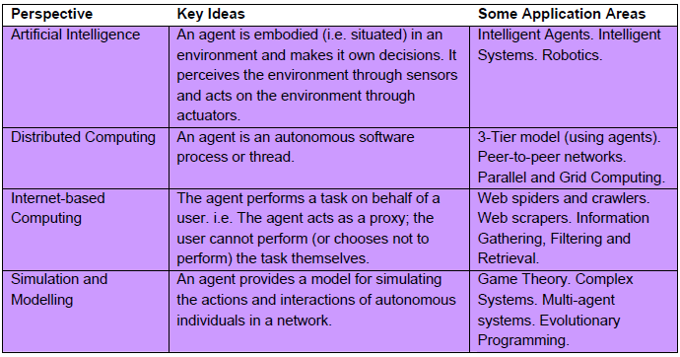
WHAT IS AN AGENT ?

Slide 23
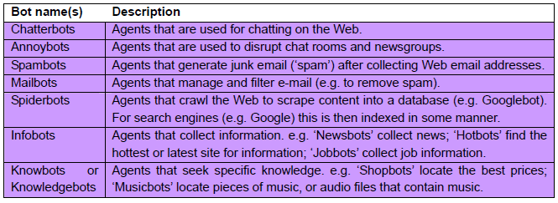
ROBOTS AND THEIR APPLICATION

Slide 24
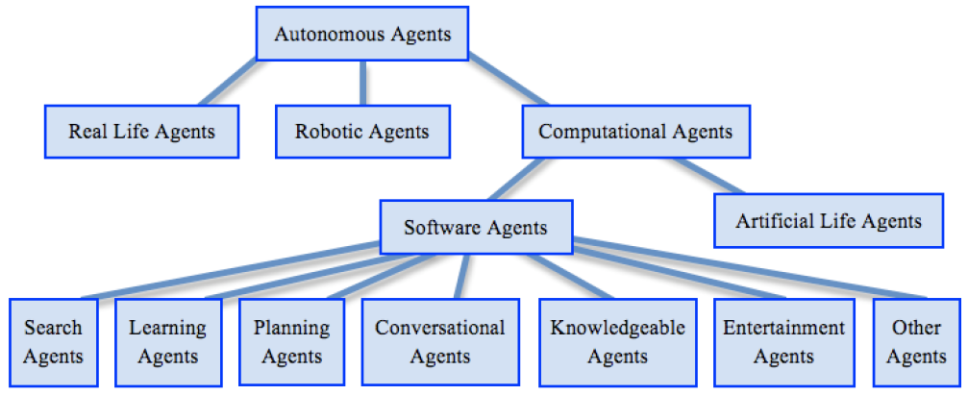
TAXONOMY OF AUTONOMOUS AGENT

Slide 25
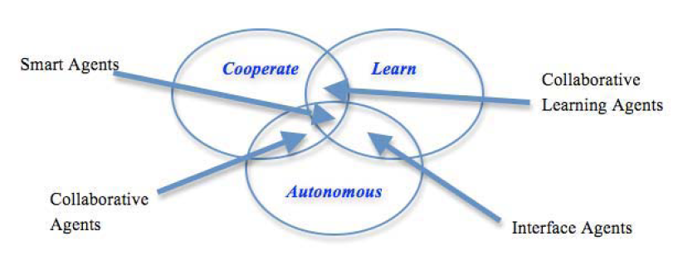
AGENT TOPOLOGY

Slide 26
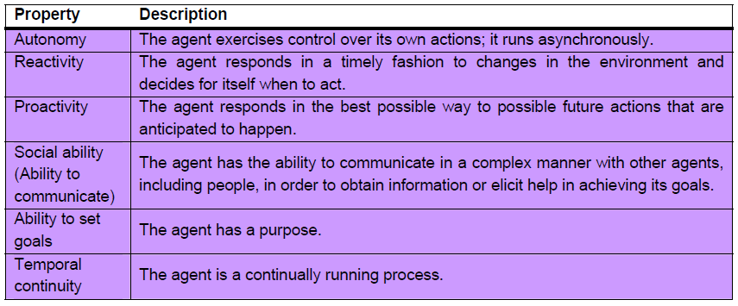
DESIRABLE PROPERTIES OF AGENT

Slide 27
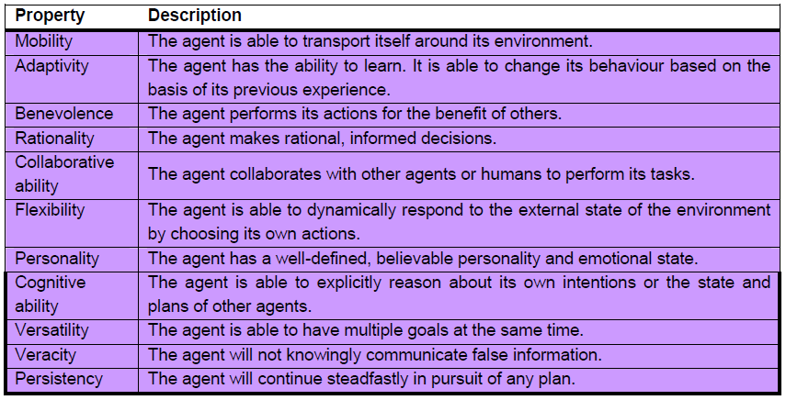
DESIRABLE PROPERTIES OF AGENT
Continued..

Slide 28
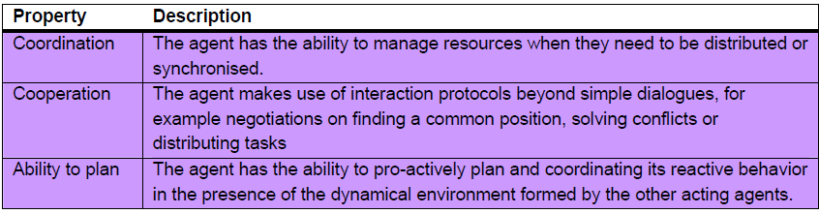
DESIRABLE PROPERTIES OF AGENT
Continued..

Slide 29
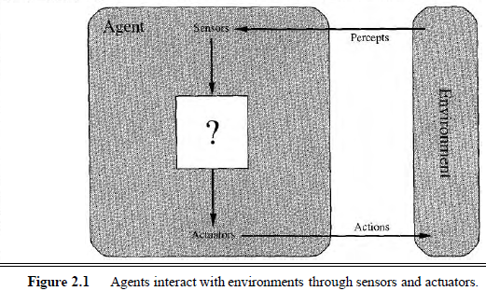
AGENT AND ENVIRONMENT
ENVIRONMENT
SENSOR
ACTUATORS
PERCEPT
PERCEPT SEQUENCE
AGENT FUNCTION
AGENT PROGRAM

Slide 30
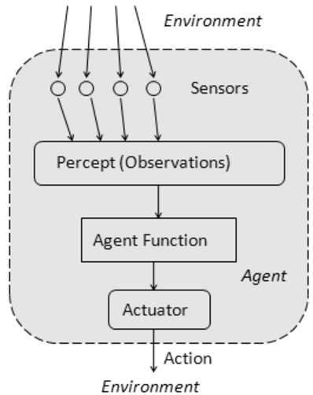
AGENT FUNCTION
The agent function is a mathematical function that maps a sequence of perceptions into action.
The function is implemented as the agent program.
The part of the agent taking an action is called an actuator.
environment -> sensors -> agent function -> actuators -> environment

Slide 31
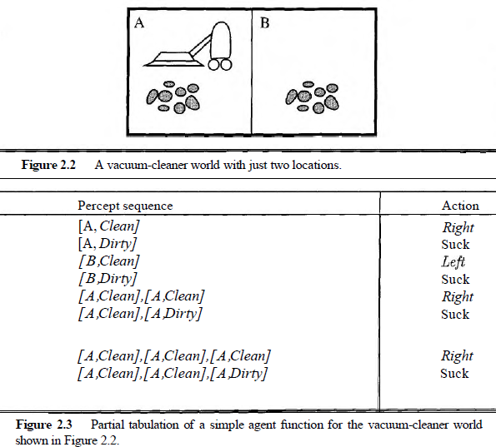
VACUUM CLEANING AGENT

Slide 32
GOOD BEHAVIOR: THE CONCEPT OF RATIONALITY
Rational Agent
- one does the right thing
- Every entry in the table for the agent function is filled out correctly
What does it mean to do the right thing ?
by considering the consequences of the agent's behavior
Agent - >plunked down in an environment
-> generates a sequence of actions
-> according to the percepts it receives.
sequence of actions -> causes
-> the environment
-> to go through a sequence of states.
If the sequence of states is desirable, then the agent has performed well.
performance Measure –
evaluates any given sequence of environment states

Slide 33
RATIONAL AGENT
A rational agent is one that can take the right decision in every situation.
Performance measure: a set of criteria/test bed for the success of the agent's behavior.
The performance measures should be based on the desired effect of the agent on the environment.

Slide 34
RATIONALITY
The agent's rational behavior depends on:
the performance measure that defines success
the agent's knowledge of the environment
the action that it is capable of performing
the current sequence of perceptions.
Definition: for every possible percept sequence, the agent is expected to take an action that will maximize its performance measure.

Slide 35
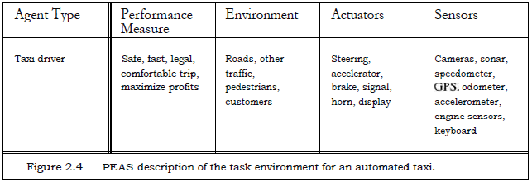
SPECIFYING THE TASK ENVIRONMENT: PEAS DESCRIPTION

Slide 36
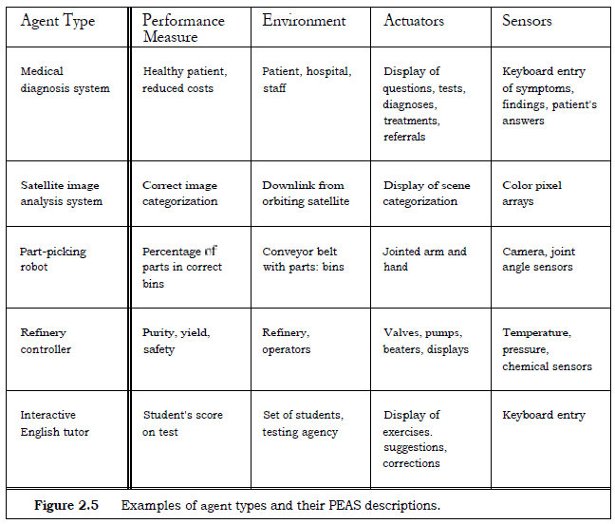
PEAS: Examples

Slide 37
PROPERTIES OF TASK ENVIRONMENT
Fully v/s Partially Observable
Unobservable
Single Agent v/s Multi Agent
Deterministic v/s Stochastic
Nondeterministic
Uncertain Environment
Episodic V/s Sequential
Static v/s Dynamic
Discrete v/s Continuous
Known v/s Unknown

Slide 38
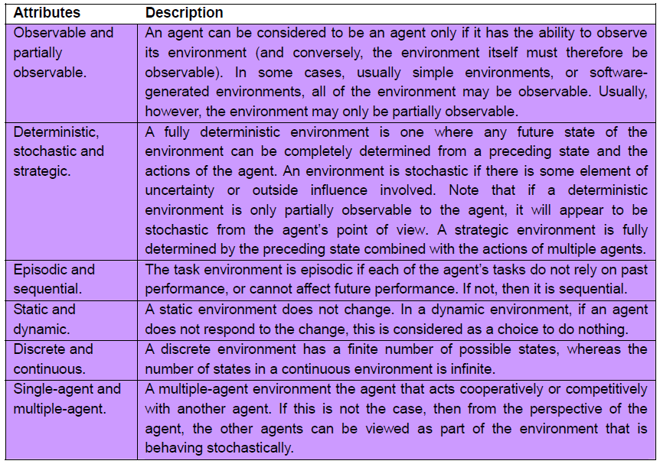
PROPERTIES OF TASK ENVIRONMENT

Slide 39
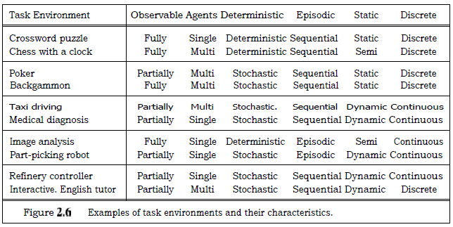
TASK ENVIRONMENT: EXAMPLES

Slide 40
THE STRUCTURE OF AGENTS
Architecture: computing device + physical sensors and actuators
architecture makes the percepts from the sensors available to the agent program,
runs the program,
and feeds the program's action choices to the actuators as they are generated.
Agent programs
take the current percept as input from the sensors and return an action to the actuators.

Slide 41
AGENT EXAMPLE: TABLE DRIVEN AGENT
Table-driven agents: the function consists in a lookup table of actions to be taken for every possible state of the environment.
If the environment has n variables, each with t possible states, then the table size is t^{n}.
Only works for a small number of possible states for the environment.
Simple reflex agents: deciding on the action to take based only on the current perception and not on the history of perceptions.
Based on the condition-action rule: (if (condition) action)
Works if the environment is fully observable

Slide 42
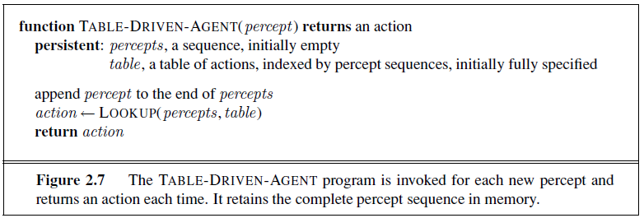
TABLE-DRIVEN-AGENT

Slide 43
VACUUM CLEANING AGENT: Table Driven

Slide 44
Table Drives
percepts = []
table = {}
def table_agent (percept):
action = True
percepts.append(percept)
action = lookup(percepts, table)
return action

Slide 45
LIMITATION OF TABLE-DRIVEN AGENT
no physical agent in this universe will have the space to store the table,
the designer would not have time to create the table,
no agent could ever learn all the right table entries from its experience, and
even if the environment is simple enough to yield a feasible table size, the designer still has no guidance about how to fill in the table entries

Slide 46
BASIC KINDS OF AGENT PROGRAMS
Simple reflex agents
Model-based reflex agents
Goal-based agents
Utility-based agents.

Slide 47
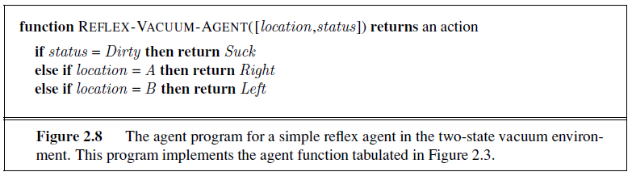
SIMPLE REFLEX AGENTS
select actions on the basis of the current percept, ignoring the rest of the percept history.
a condition-action rule, written as
if car-in-front-is-braking then initiate-braking.
general and flexible approach is first to build a
general-purpose interpreter for condition-action rules and
then to create rule sets for specific task environments.

Slide 48
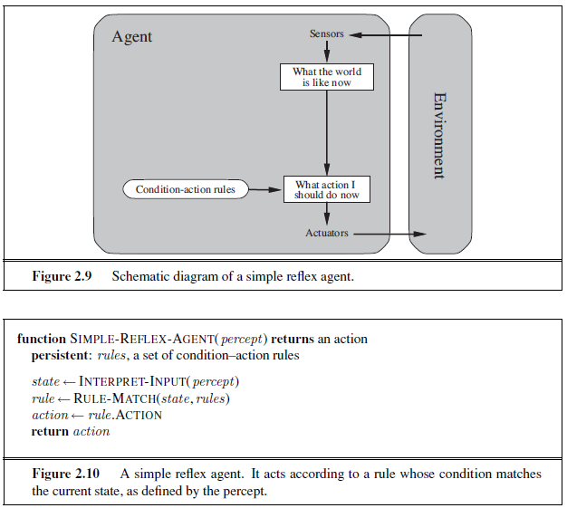
Background Information
used in the Process
Current internal state
of Decision Process
Only if the Environment is
Fully Observable
What will happen? when,
Vacuum Cleaner with poor perception!
Without location sensor !

Slide 49
MODEL-BASED REFLEX AGENTS
keep track of the part of the world it can't see now. [handle partial observability]
model of the world
That is, the agent should maintain some sort of internal state that depends on the percept history and thereby reflects at least some of the unobserved aspects of the current state.
Updating this internal state information as time goes by requires two kinds of knowledge to be encoded in the agent program.
First, we need some information about how the world evolves independently of the agent
[ex. overtaking car]
Second, we need some information about how the agent's own actions affect the world
[ex. Turn steering wheel clockwise..]
This knowledge about "how the world works"—whether implemented in simple Boolean circuits or in complete scientific theories - is called a model of the world.

Slide 50
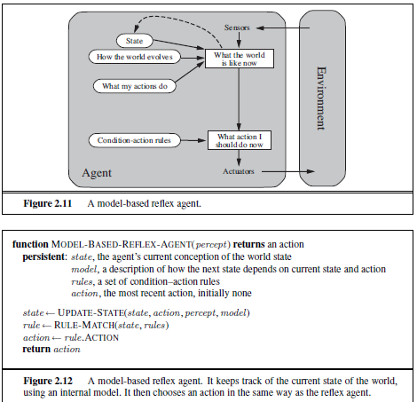

Slide 51
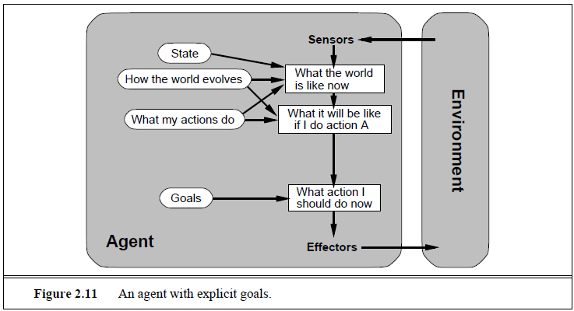
GOAL-BASED AGENT
Searching
Planning
decision making

Slide 52
UTILITY-BASED AGENTS
Goals alone are not enough to generate high-quality behavior in most environments.
An agent's utility function is essentially an internalization of the performance measure.
flexibility and learning
In two kinds of cases, goals are inadequate, but a utility-based agent can still make rational decisions
when there are conflicting goals, only some of which can be achieved
(for example, speed and safety), the utility function specifies the appropriate tradeoff.
2. when there are several goals that the agent can aim for, none of which can be achieved with certainty, utility provides a way in which the likelihood of success can be weighed against the importance of the goals.

Slide 53
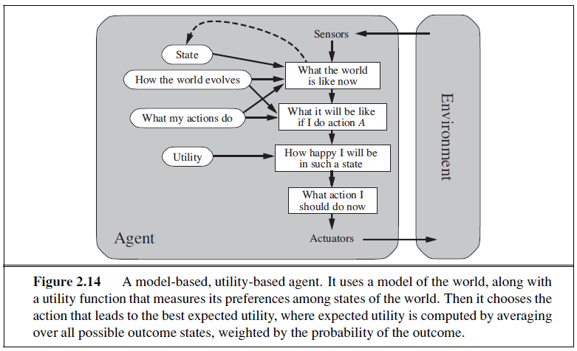

Slide 54
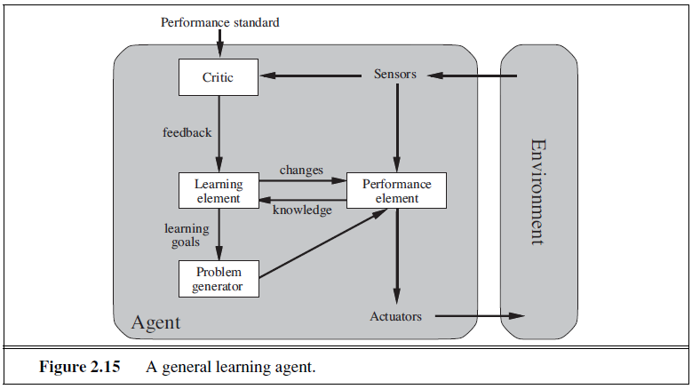
LEARNING AGENT

Slide 55
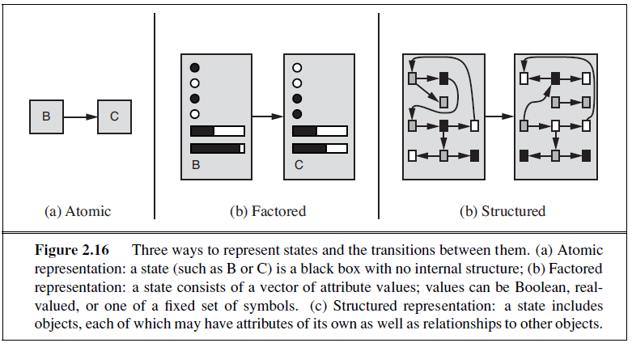
HOW COMPONENT OF AGENT PROGRAMS WORK

Slide 56
References
Chapter 2: Intelligent Agents , Pages 34-58
“Artificial Intelligence: A Modern Approach,” by Stuart J. Russell and Peter Norvig,

Slide 57
Solving Problem by Searching : Uninformed Search
Course Code: CSC4226
Course Title: Artificial Intelligence and Expert System
Dept. of Computer Science
Faculty of Science and Technology
Lecture No: | Three (3) | Week No: | Three (3) | Semester:
Lecturer: | Dr. Muhammad Firoz Mridha, Associate Professor, Dept of CS Email: firoz.mridha@aiub.edu

Slide 58
Lecture Outline
Problem-Solving Agents
Example Problems
Searching for Solutions
Uninformed Search Strategies

Slide 59
PROBLEM SOLVING AGENTS
Simple Reflexive Agent
Base their action on a direct mapping from
STATEs to ACTIONs
Goal Based Agent
Consider future Actions and the desirability of their outcomes
Problem Solving Agent
Goal based Agent
Use Atomic representation of Environment
Planning Agent
Goal based Agent
Use more advanced factored/structured representation

Slide 60
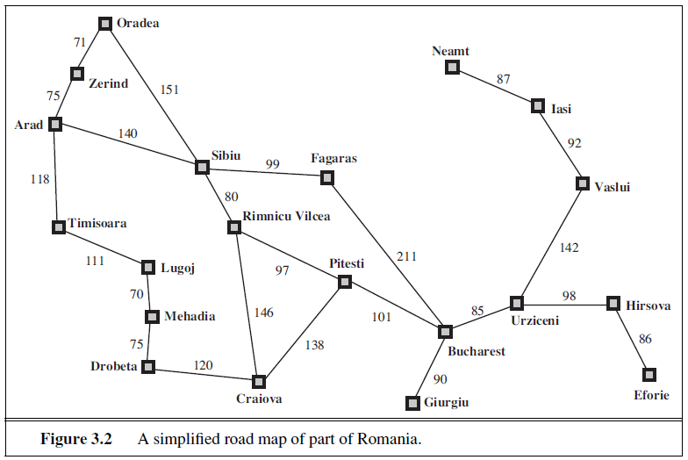
FORMULATE-SEARCH-EXECUTE
Goal Formulation
Problem Formulation
Environment
examining future actions
Formulate, Search, Execution
Open Loop System

Slide 61
GOAL FORMULATION
Goals help organize behavior by limiting the objectives that the agent is trying to achieve and hence the actions it needs to consider.
Goal formulation, based on the current situation and the agent’s performance measure, is the first step in problem solving
Goal: A set of world states—exactly those states in which the goal is satisfied.
The agent’s task is to find out
how to act, now and in the future, so that it reaches a goal state.

Slide 62
PROBLEM FORMULATION: BASED ON ENVIRONMENT
Problem formulation is the process of deciding what actions and states to consider, given a goal.
In an Unknown environment the agent will not know which of its possible actions is best, because it does not yet know enough about the state that results from taking each action.
If the agent has no additional information—i.e., if the environment is unknown in the sense defined in Section 2.3—then it is having no choice but to try one of the actions at random.
an agent with several immediate options of unknown value can decide what to do by first examining future actions that eventually lead to states of known value.

Slide 63
SEARCH-SOLUTION-EXECUTE: OPEN LOOP SYSTEM
The process of looking for a sequence of actions that reaches the goal is called search.
Solution is the sequence of actions that takes any agent to the goal state, exactly those state the agent is satisfied.
A search algorithm takes a problem as input and returns a solution in the form of an action sequence.
While the agent is executing the solution sequence it ignores its percepts when choosing an action because it knows in advance what they will be. An agent that carries out its plans with its eyes closed.
Control theorists call this an open-loop system, because ignoring the percepts breaks the loop between agent and environment.

Slide 64
WELL-DEFINED PROBLEMS
A problem can be defined formally by five components:
1. The initial state that the agent starts in. For example, the initial state for our agent in Romania might be described as In(Arad).
2. A description of the possible actions available to the agent. Given a particular state s, ACTIONS(s) returns the set of actions that can be executed in s. We say that each of these actions is applicable in s. For example, from the state In(Arad), the applicable actions are {Go(Sibiu), Go(Timisoara), Go(Zerind)}.
3. A description of what each action does; the formal name for this is the transition model, specified by a function RESULT(s, a) that returns the state that results from doing action a in state s. We also use the term successor to refer to any state reachable from a given state by a single action.2 For example, we have RESULT(In(Arad),Go(Zerind)) = In(Zerind) .
4. The goal test, which determines whether a given state is a goal state.
5. A path cost function that assigns a numeric cost to each path.

Slide 65
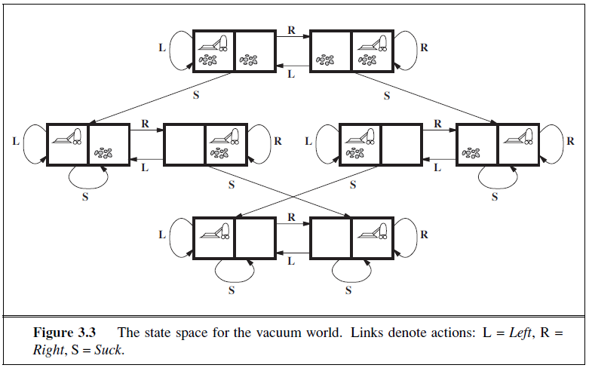
TOY PROBLEMS

Slide 66
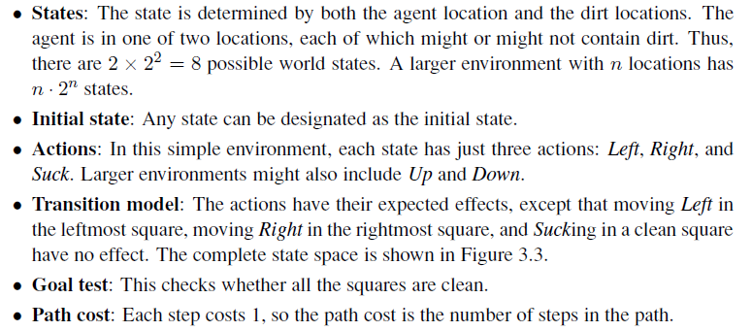
VACUUM WORLD: PROBLEM FORMULATION

Slide 67
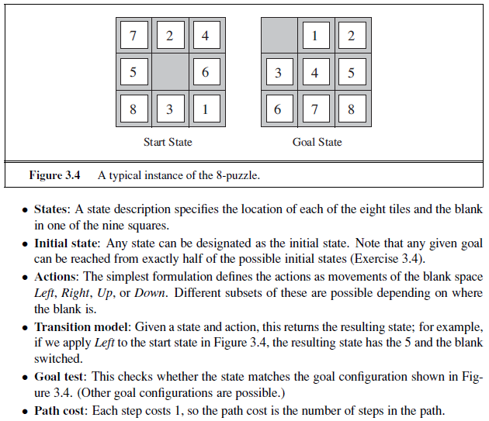
8-PUZZLE: PROBLEM FORMULATION

Slide 68
SEARCHING FOR SOLUTIONS
A solution is an action sequence, so search algorithms work by considering various possible action sequences
The possible action sequences starting at the initial state form a search tree with the initial state at the root; the branches are actions and the nodes correspond to states in the state space of the problem.
Expanding the current state is, applying each legal action to the current state, thereby generating a new set of states

Slide 69
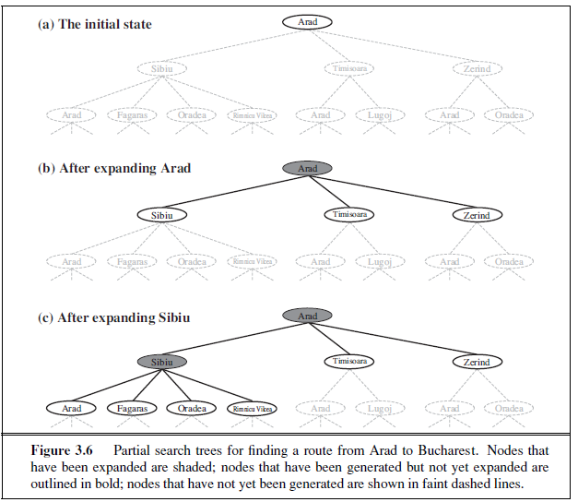
SEARCH TREE

Slide 70
SEARCH STRATEGY
the essence of search—following up one option now and putting the others aside for later, in case the first choice does not lead to a solution.
The set of all leaf nodes available for expansion at any given point is called the frontier.
The process of expanding nodes on the frontier continues until either a solution is found or there are no more states to expand.
Search algorithms all share this basic structure;
they vary primarily according to how they choose which state to expand next —the so-called search strategy.

Slide 71
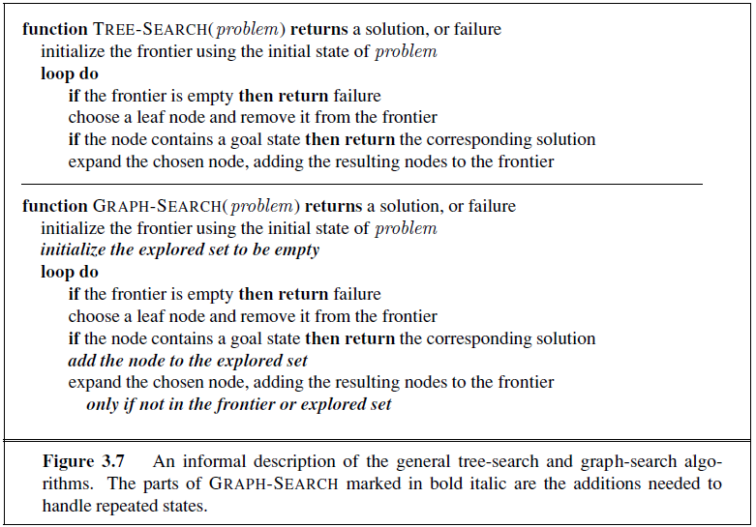
TREE SEARCH / GRAPH SEARCH

Slide 72
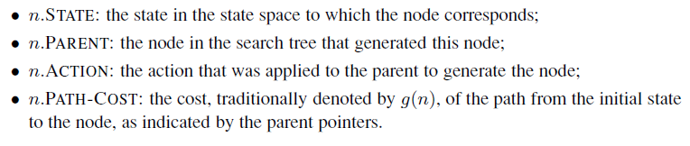
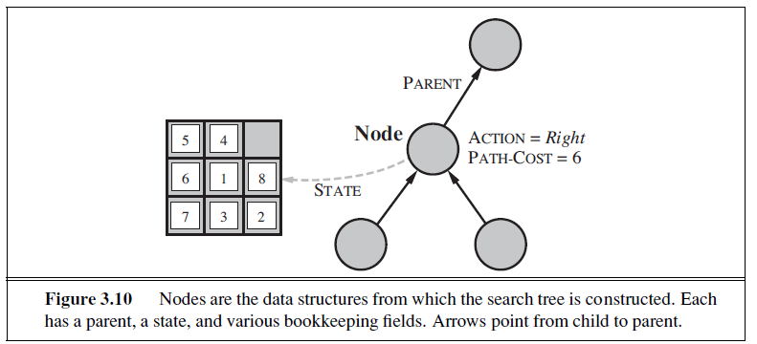
INFRASTRUCTURE FOR SEARCH ALGORITHMS

Slide 73
FRONTIER [FRINGE]
The frontier needs to be stored in such a way that the search algorithm can easily choose the next node to expand according to its preferred strategy. The appropriate data structure for this is a queue.
The operations on a queue are as follows:
• EMPTY?(queue) returns true only if there are no more elements in the queue.
• POP(queue) removes the first element of the queue and returns it.
• INSERT(element, queue) inserts an element and returns the resulting queue.
Queues are characterized by the order in which they store the inserted nodes. Three common variants are -
the first-in, first-out For FIFO queue, which pops the oldest element of the queue;
the last-in, first-out or LIFO queue (also known as a stack), which pops the newest element of the queue; and
the priority queue,

Slide 74
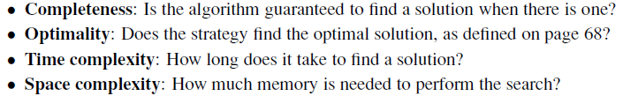
MEASURING PROBLEM-SOLVING PERFORMANCE

Slide 75
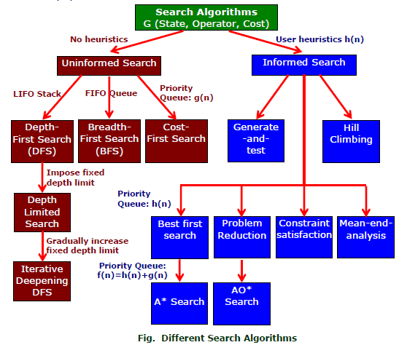
SEARCH ALGORITHMS

Slide 76
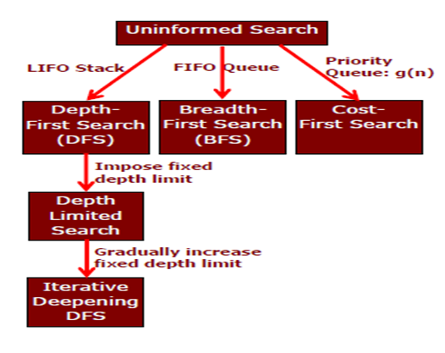
UNINFORMED SEARCH STRATEGIES

Slide 77
BREADTH-FIRST SEARCH
Breadth-first search is a simple strategy in which the root node is expanded first, then all the successors of the root node are expanded next, then their successors, and so on.
In general, all the nodes are expanded at a given depth in the search tree before any nodes at the next level are expanded.
Breadth-first search is an instance of the general graph-search algorithm (Figure 3.7) in which the shallowest unexpanded node is chosen for expansion.
This is achieved very simply by using a FIFO queue for the frontier.
Thus, new nodes (which are always deeper than their parents) go to the back of the queue, and old nodes, which are shallower than the new nodes, get expanded first.
The goal test is applied to each node when it is generated rather than when it is selected for expansion.
Following the general template for graph search, discards any new path to a state already in the frontier or explored set

Slide 78
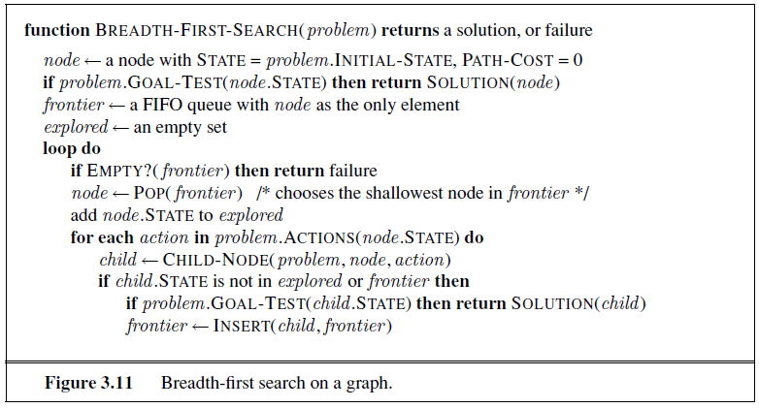
BREADTH-FIRST SEARCH: PSEUDOCODE

Slide 79
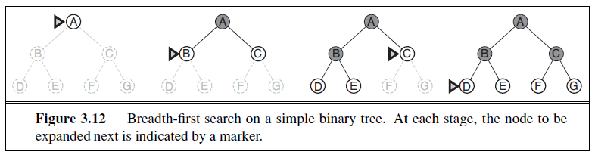
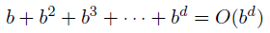
BREADTH-FIRST SEARCH: FOUR CRITERIA
complete—if the shallowest goal node is at some finite depth d, breadth-first search will eventually find it after generating all shallower nodes.
Breadth-first search is optimal if the path cost is a nondecreasing function of the depth of the node.
For uniform tree, the total number of nodes generated is
The time complexity would be O(b^{d+1})
The space complexity is O(b^{d})

Slide 80
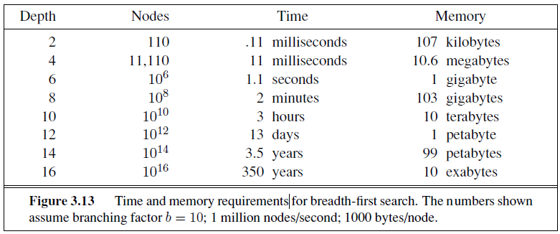
BREADTH-FIRST SEARCH: MEMORY REQUIREMENTS

Slide 81
UNIFORM-COST SEARCH
Instead of expanding the shallowest node, uniform-cost search expands the node n with the lowest path cost g(n).
This is done by storing the frontier as a priority queue ordered by g
Two other significant differences from breadth-first search
The goal test is applied to a node when it is selected for expansion rather than when it is first generated
A test is added in case a better path is found to a node currently on the frontier.

Slide 82

UNIFORM-COST SEARCH: PSEUDOCODE

Slide 83

UNIFORM-COST SEARCH: ILLUSTRATION

Slide 84
UNIFORM-COST SEARCH: OPTIMALITY
Observe that whenever uniform-cost search selects a node n for expansion, the optimal path to that node has been found.
Were this not the case, there would have to be another frontier node n’ on the optimal path from the start node to n, n’ would have lower g-cost than n and would have been selected first
Then, because step costs are nonnegative, paths never get shorter as nodes are added
These two facts together imply that
uniform-cost search expands nodes in order of their optimal path cost.
Hence, the first goal node selected for expansion must be the optimal solution.

Slide 85
UNIFORM-COST SEARCH: COMPLETENESS & COMPLEXITY
Completeness is guaranteed provided the cost of every step exceeds some small positive constant ε.
Uniform-cost search is guided by path costs rather than depths, so its complexity is not easily characterized in terms of b and d.
Instead, let C* be the cost of the optimal solution, and assume that every action costs at least ε .
Then the algorithm’s worst-case time and space complexity is O(b ^{1+[C*/ε]}), which can be much greater than b^{d}.
When all step costs are equal, b ^{1+ [C∗/ε]} is just b^{d+1}.

Slide 86
DEPTH-FIRST SEARCH
Depth-first search always expands the deepest node in the current frontier of the search tree.
The search proceeds immediately to the deepest level of the search tree, where the nodes have no successors
As those nodes are expanded, they are dropped from the frontier, so then the search “backs up” to the next deepest node that still has unexplored successors.
The depth-first search algorithm is an instance of the graph-search algorithm, where it uses a LIFO queue

Slide 87

DEPTH-FIRST SEARCH: SEARCH TREE

Slide 88
DEPTH-FIRST SEARCH: Optimality, Complexity, Completeness
The graph-search version, which avoids repeated states and redundant paths, is complete in finite state spaces because it will eventually expand every node. The tree-search version, on the other hand, is not complete In infinite state spaces, both versions fail if an infinite non-goal path is encountered.
Both versions are nonoptimal. For example, in Figure 3.16, depth first search will explore the entire left subtree even if node C is a goal node. If node J were also a goal node, then depth-first search would return it as a solution instead of C, which would be a better solution; hence, depth-first search is not optimal.
A depth-first tree search, may generate all of the O(b^{m}) nodes in the search tree, where m is the maximum depth of any node; this can be much greater than the size of the state space.
For a state space with branching factor b and maximum depth m, depth-first search requires storage of only O(bm) nodes.

Slide 89

DFS v/s BFS

Slide 90

DFS v/s BFS

Slide 91
DEPTH-LIMITED SEARCH
The embarrassing failure of depth-first search in infinite state spaces can be alleviated by supplying depth-first search with a predetermined depth limit .
That is, nodes at depth are treated as if they have no successors.
This approach is called depth-limited search
Depth-limited search will also be nonoptimal if we choose l> d. Its time complexity is O(b^{l}) and its space complexity is O(bl).
Depth-first search can be viewed as a special case of depth-limited search with l=∞.

Slide 92

DEPTH-LIMITED SEARCH: PSEUDOCODE

Slide 93
ITERATIVE DEEPENING DEPTH-FIRST SEARCH
Iterative deepening search (or iterative deepening depth-first search) is a general strategy, often used in combination with depth-first tree search, that finds the best depth limit.
It does this by gradually increasing the limit—first 0, then 1, then 2, and so on—until a goal is found
Iterative deepening combines the benefits of depth-first and breadth-first search.
Like depth-first search, its memory requirements are modest: O(bd) to be precise.
Like breadth-first search, it is complete when the branching factor is finite and optimal when the path cost is a nondecreasing function of the depth of the node

Slide 94

ITERATIVE DEEPENING DEPTH-FIRST SEARCH TREE

Slide 95

IDP: COMPLEXITY
Iterative deepening search may seem wasteful because states are generated multiple times. It turns out this is not too costly.
The reason is that in a search tree with the same (or nearly the same) branching factor at each level, most of the nodes are in the bottom level, so it does not matter much that the upper levels are generated multiple times.
In an iterative deepening search, the nodes on the bottom level (depth d) are generated once, those on the next-to-bottom level are generated twice, and so on, up to the children of the root, which are generated d times.
So the total number of nodes generated in the worst case is

Slide 96

BIDIRECTIONAL SEARCH
The idea behind bidirectional search is to run two simultaneous searches—one forward from the initial state and the other backward from the goal—hoping that the two searches meet in the middle
Bidirectional search is implemented by replacing the goal test with a check to see whether the frontiers of the two searches intersect;

Slide 97

COMPARING UNINFORMED SEARCH STRATEGIES

Slide 98
INFORMED (HEURISTIC) SEARCH STRATEGIES
Course Code: CSC4226
Course Title: Artificial Intelligence and Expert System
Dept. of Computer Science
Faculty of Science and Technology
Lecture No: | Four (4) | Week No: | Four (4) | Semester:
Lecturer: | Dr. Muhammad Firoz Mridha, Associate Professor, Dept of CS Email: firoz.mridha@aiub.edu

Slide 99
LECTURE OUTLINE
BEST-FIRST SEARCH
GREEDY BEST-FIRST SEARCH
A* SEARCH
CONDITIONS FOR OPTIMALITY
OPTIMALITY OF A*

Slide 100

Romania with step costs in km

Slide 101
INFORMED SEARCH STRATEGY
Informed search strategy—
one that uses problem-specific knowledge beyond the definition of the problem itself
can find solutions more efficiently than can an uninformed strategy.
problem-specific knowledge
is the extra bit of information the program uses rather than
the problem formulation, thus known as Informed Search

Slide 102
BEST-FIRST SEARCH
The general approach to informed search is called best-first search
Best-first search is an instance of the general TREE-SEARCH or GRAPH-SEARCH algorithm in which a node is selected for expansion based on an evaluation function, f(n).
The evaluation function is construed as a cost estimate, so the node with the lowest evaluation is expanded first
The implementation of best-first graph search is identical to that for uniform-cost search, except for the use of f instead of g to order the priority queue.
The choice of f determines the search strategy.

Slide 103

HEURISTIC SEARCH COMPARED WITH BLIND SEARCH

Slide 104
HEURISTIC FUNCTION
The choice of f(evaluation function) determines the search strategy
Best-first algorithms include as a component of f a heuristic function, denoted h(n)
h(n) = estimated cost of the cheapest path from the state at node n to a goal state.
h(n) takes a node as input, but, unlike g(n), it depends only on the state at that node.
Heuristic functions are the most common form in which additional knowledge of the problem is imparted to the search algorithm
Consider them to be arbitrary, nonnegative, problem-specific functions, with one constraint: if n is a goal node, then h(n)=0.

Slide 105
GREEDY BEST-FIRST SEARCH
Greedy best-first search8 tries to expand the node that is closest to the goal, on the grounds that this is likely to lead to a solution quickly.
Thus, it evaluates nodes by using just the heuristic function; that is, f(n) = h(n).
“greedy”—at each step it tries to get as close to the goal as it can.
Its search cost is minimal. It is not optimal.
Greedy best-first tree search is also incomplete even in a finite state space, much like depth-first search.

Slide 106

STRAIGHT-LINE DISTANCE HEURISTIC

Slide 107

GREEDY BEST-FIRST TREE SEARCH

Slide 108
A* SEARCH: MINIMIZING THE TOTAL ESTIMATED SOLUTION COST
The most widely known form of best-first search is called A*search
It evaluates nodes by combining
g(n), the cost to reach the node, and
h(n), the cost to get from the node to the goal:
f(n) = g(n) + h(n) .
Since
g(n) gives the path cost from the start node to node n, and
h(n) is the estimated cost of the cheapest path from n to the goal,
we have f(n) = estimated cost of the cheapest solution through n .
A∗ search is both complete and optimal.
The algorithm is identical to UNIFORM-COST-SEARCH except that
A∗ uses g + h instead of g.

Slide 109
We have now arrived at Bucharest. As this is the lowest cost node AND the goal state we can terminate the search. If you look back over the slides you will see that the solution returned by the A* search pattern ( Arad – Sibiu – Rimnicu – Pitesti – Bucharest ), is in fact the optimal solution. Press space to continue with the slideshow.
In actual fact, the algorithm will not really recognise that we have found Bucharest. It just keeps expanding the lowest cost nodes (based on f ) until it finds a goal state AND it has the lowest value of f. So, we must now move to Fagaras and expand it. Press space to continue.
Press space to see an A* search of the Romanian map featured in the previous slide. Note: Throughout the animation all nodes are labelled with f(n) = g(n) + h(n). However,we will be using the abbreviations f, g and h to make the notation simpler
We now expand Sibiu (that is, we expand the node with the lowest value of f ). Press space to continue the search.
We now expand Rimnicu (that is, we expand the node with the lowest value of f ). Press space to continue the search.
We now expand Pitesti (that is, we expand the node with the lowest value of f ). Press space to continue the search.
Once Arad is expanded we look for the node with the lowest cost. Sibiu has the lowest value for f. (The cost to reach Sibiu from Arad is 140 miles, and the straight line distance from Sibiu to the goal state is 253 miles. This gives a total of 393 miles). Press space to move to this node and expand it.
Once Rimnicu is expanded we look for the node with the lowest cost. As you can see, Pitesti has the lowest value for f. (The cost to reach Pitesti from Arad is 317 miles, and the straight line distance from Pitesti to the goal state is 98 miles. This gives a total of 415 miles). Press space to move to this node and expand it.
We have just expanded a node (Pitesti) that revealed Bucharest, but it has a cost of 418. If there is any other lower cost node (and in this case there is one cheaper node, Fagaras, with a cost of 417) then we need to expand it in case it leads to a better solution to Bucharest than the 418 solution we have already found. Press space to continue.
We begin with the initial state of Arad. The cost of reaching Arad from Arad (or g value) is 0 miles. The straight line distance from Arad to Bucharest (or h value) is 366 miles. This gives us a total value of ( f = g + h ) 366 miles. Press space to expand the initial state of Arad.
We now expand Fagaras (that is, we expand the node with the lowest value of f ). Press space to continue the search.
Zerind
F= 75 + 374
F= 449
Oradea
F= 291 + 380
F= 671
Arad
F= 0 + 366
F= 366
Fagaras
Sibiu
F= 239 + 178
F= 417
F= 140 + 253
F= 393
Bucharest(2)
F= 118 + 329
F= 447
F= 220 + 193
F= 413
Rimnicu
F= 450 + 0
F= 450
Timisoara
Bucharest
Bucharest
Bucharest
Bucharest
Pitesti
F= 418 + 0
F= 418
Craiova
F= 317 + 98
F= 415
F= 366 + 160
F= 526
Once Fagaras is expanded we look for the lowest cost node. As you can see, we now have two Bucharest nodes. One of these nodes ( Arad – Sibiu – Rimnicu – Pitesti – Bucharest ) has an f value of 418. The other node (Arad – Sibiu – Fagaras – Bucharest(2) ) has an f value of 450. We therefore move to the first Bucharest node and expand it. Press space to continue

Slide 110

A∗ SEARCH FOR BUCHAREST

Slide 111

A∗ SEARCH FOR BUCHAREST

Slide 112
CONDITIONS FOR OPTIMALITY: ADMISSIBILITY AND CONSISTENCY
The first condition we require for optimality is that h(n) be an admissible heuristic
An admissible heuristic is one that never overestimates the cost to reach the goal
Because g(n) is the actual cost to reach n along the current path, and f(n)=g(n) + h(n), we have as an immediate consequence that f(n) never overestimates the true cost of a solution along the current path through n.
Admissible heuristics are by nature optimistic because they think the cost of solving the problem is less than it actually is.

Slide 113

ADMISSIBILITY

Slide 114
CONSISTENCY
A second, slightly stronger condition called consistency (or sometimes monotonicity) is required only for applications of A∗ to graph search.
A heuristic h(n) is consistent if, for every node n and every successor n of n generated by any action a, the estimated cost of reaching the goal from n is no greater than the step cost of getting to n plus the estimated cost of reaching the goal from n :
h(n) ≤ c(n, a, n’) + h(n’).
This is a form of the general triangle inequality, which stipulates that each side of a triangle cannot be longer than the sum of the other two sides

Slide 115
OPTIMALITY OF A*
A∗ has the following properties: the tree-search version of A∗ is optimal if h(n) is admissible, while the graph-search version is optimal if h(n) is consistent.
if h(n) is consistent, then the values of f(n) along any path are nondecreasing.
The proof follows directly from the definition of consistency. Suppose n is a successor of n; then g(n’)=g(n) + c(n, a, n’) for some action a, and we have
f(n) = g(n) + h(n) = g(n) + c(n, a, n) + h(n) ≥ g(n) + h(n) = f(n) .
The next step is to prove that whenever A∗ selects a node n for expansion, the optimal path to that node has been found. Were this not the case, there would have to be another frontier node n on the optimal path from the start node to n. because f is nondecreasing along any path, n would have lower f-cost than n and would have been selected first.

Slide 116
Local search algorithms
The search algorithms that we have seen so far are designed to explore search space systematically
Systematicity is achieved by keeping one or more paths in memory and by recording which alternatives have been explored at each point along the path and which have not
When a goal is found, the path to that goal also constitute a solution to the problem
In many optimization problems, the path to the goal is irrelevant; the goal state itself is the solution
In such cases, we can use local search algorithms
keep a single "current" state, try to improve it

Slide 117

Example: n-queens
Put n queens on an n × n board with no two queens on the same row, column, or diagonal

Slide 118

Hill-climbing search
"Like climbing Everest in thick fog with amnesia"

Slide 119

Hill-climbing search
Problem: depending on initial state, can get stuck in local maxima

Slide 120

Hill-climbing search: 8-queens problem
h = number of pairs of queens that are attacking each other, either directly or indirectly
h = 17 for the above state

Slide 121

Hill-climbing search: 8-queens problem
A local minimum with h = 1

Slide 122
AI - HEURISTIC SEARCH
Heuristic search refers to a search strategy that attempts to optimize a problem by iteratively improving the solution based on a given heuristic function or a cost measure.
A Heuristic is a technique to solve a problem faster than classic methods, or to find an approximate solution when classic methods cannot.
This is a kind of a shortcut as we often trade one of optimality, completeness, accuracy, or precision for speed.

Slide 123

Fig 4.1 First three levels of the tic-tac-toe state space reduced by symmetry

Slide 124

Fig 4.2 The “most wins” heuristic applied to the first children in tic-tac-toe.

Slide 125

Fig 4.3 Heuristically reduced state space for tic-tac-toe.
4

Slide 126

Fig 4.12 The start state, first moves, and goal state for an example-8 puzzle.
Notes:
Insert fig 4.12

Slide 127

Fig 4.14 Three heuristics applied to states in the 8-puzzle.

Slide 128

Fig 4.15 The heuristic f applied to states in the 8-puzzle.
Notes:
Insert fig 4.15

Slide 129

Fig 4.16 State space generated in heuristic search of the 8-puzzle graph.
Notes:
Insert fig 4.16

Slide 130

Fig 4.17 Open and closed as they appear after the 3rd iteration of heuristic search

Slide 131

Notes:
Insert def box page 146

Slide 132

Notes:
Insert def box, pg 147

Slide 133

Notes:
Insert def box, pg 148

Slide 134

Fig 4.18 Comparison of state space searched using heuristic search with space searched by breadth-first search. The proportion of the graph searched heuristically is shaded. The optimal search selection is in bold. Heuristic used is f(n) = g(n) + h(n) where h(n) is tiles out of place.

Slide 135

Fig 4.19 State space for a variant of nim. Each state partitions the seven matches into one or more piles.

Slide 136

Fig 4.22 Heuristic measuring conflict applied to states of tic-tac-toe.

Slide 137

Fig 4.23 Two-ply minimax applied to the opening move of tic-tac-toe, from Nilsson (1971).

Slide 138

Fig 4.24 Two ply minimax, and one of two possible MAX second moves, from Nilsson (1971).

Slide 139

Fig 4.25 Two-ply minimax applied to X’s move near the end of the game, from Nilsson (1971).

